Slide 2
DISCLAIMER
REMEMBER: We will be talking about methods and ways to encrypt and decrypt some cryptographic ciphers, although this isn’t illegal in itself, it can be depending on what you do. Make sure to always consult laws and common sense before doing anything that is a gray area.

Slide 3
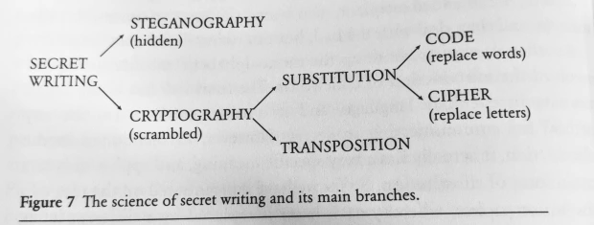
What is Cryptography?
Cryptography is the practice and study of the techniques used for hiding information in the presence of an adversary.
In other words, making messages and data for special eyes only!
Cryptography has been practiced for many centuries and is what helps keeps things secure!

Slide 4
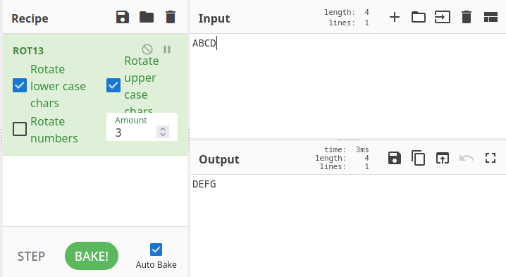
Some Other Important Definitions:
Cipher: An encryption technique that uses one letter at a time. Think of the caesar cipher where ABCD becomes DEFG.
Ciphertext: An encrypted piece of text, “DEFG” in above example.
Plaintext: The original message that you can read, “ABCD” above.
Key: Required piece to turn ciphertext to plaintext or vice versa. Not all ciphertexts need a key, but most do in some way or another.
Steganography: Hiding data in other forms of data. For example, hiding a message in an image!

Slide 5
Types of Ciphers
There are two main types of ciphers for hiding a message: Transposition Ciphers and Substitution Ciphers
Transposition Cipher: Same letters, but scrambled around in a way
Substitution Cipher: Some algorithm that replaces letters with other letters/symbols
There are other ways (Like steganography which we will cover later in this presentation) but for the most part these are the main ones that you will see.

Slide 6
Types of Ciphers
There are two main types of ciphers for hiding a message: Transposition Ciphers and Substitution Ciphers
Transposition Cipher: Same letters, but scrambled around in a way
Substitution Cipher: Some algorithm that replaces letters with other letters/symbols
There are other ways (Like steganography which we will cover later in this presentation) but for the most part these are the main ones that you will see.
There are too many types of ciphers, but you do not need to learn them all! We will go over ways to analyze and crack most ciphertext.

Slide 7
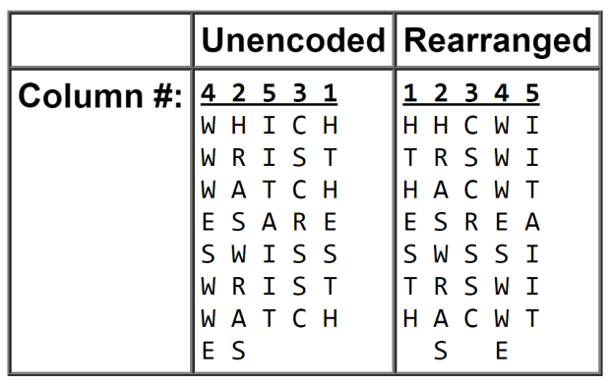
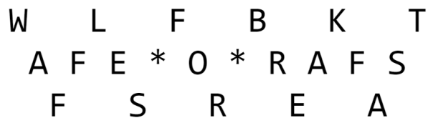
Transposition Ciphers
Transposition Ciphers will move words/letters around but not change what each individual character is
On the left is the columnar transposition cipher using the the key “42531” and the plaintext as “Which wristwatches are Swiss wristwatches” with ciphertext as “HHC WITRSWI HACW TESR EASWSSI TRS WIHAC WTSE” (spaces dont matter)
On the right is the Railfence/ZigZag Cipher using the key “3”, Plaintext as “Waffles for breakfast” and ciphertext being “ WLFBKTAFE O RAFSFSREA”
https://en.wikipedia.org/wiki/Transposition_cipher has a few others

Slide 8
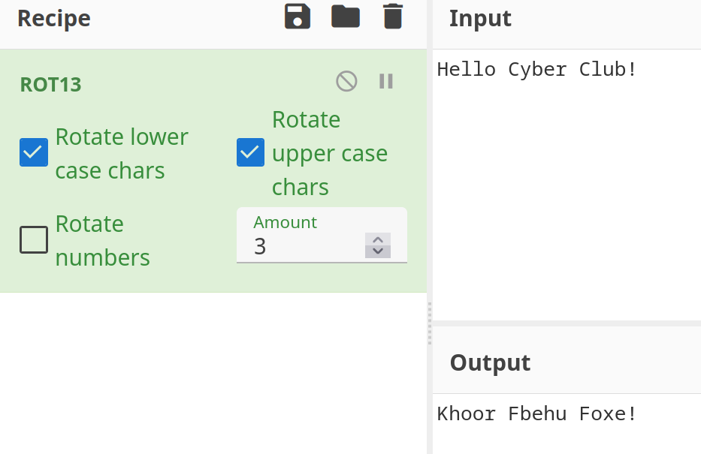
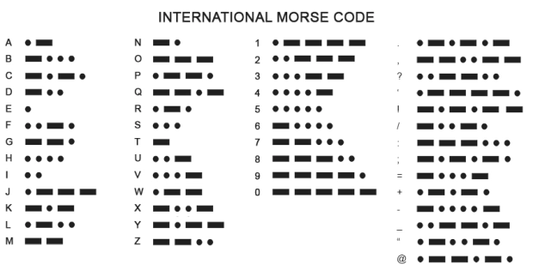
Substitution Ciphers
Substitution Ciphers are the most common that you will find and are essentially the building block of modern cryptography.
They involve replacing the letters with other letters/symbols
Ceasar Cipher/Rot 13 (left) is a “shift” cipher where you “shift” each letter alphabetically some amount. Below shows this with shift of 3.
Morse Code (Right) was a way invented to send message using short and long values (think of a beep or light or blink of an eye). “Hello” would be “.... . .-.. .-.. —”

Slide 9
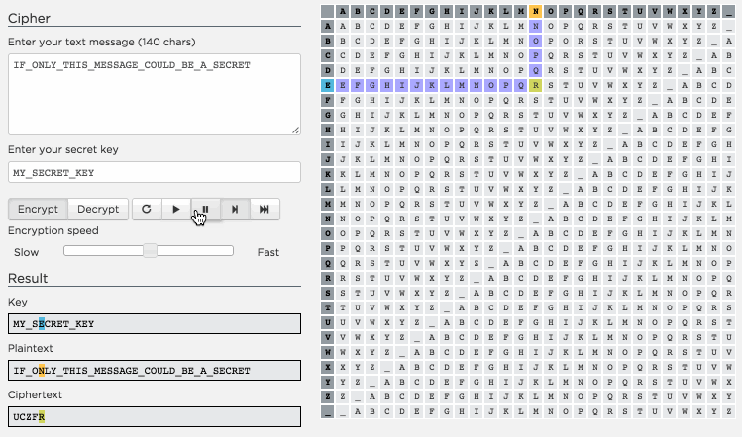
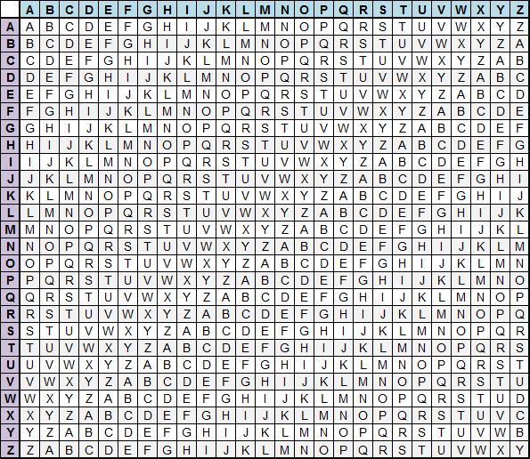
Substitution Ciphers Cont.
Atbash Cipher: The key to this is just a reversed alphabet! So plaintext “ABCD” Becomes “ZYXW”
Vigenère Cipher: This cipher uses the below table and some key to encrypt or decrypt the text.
Demo of this at https://studio.code.org/s/vigenere/lessons/1/levels/1

Slide 10
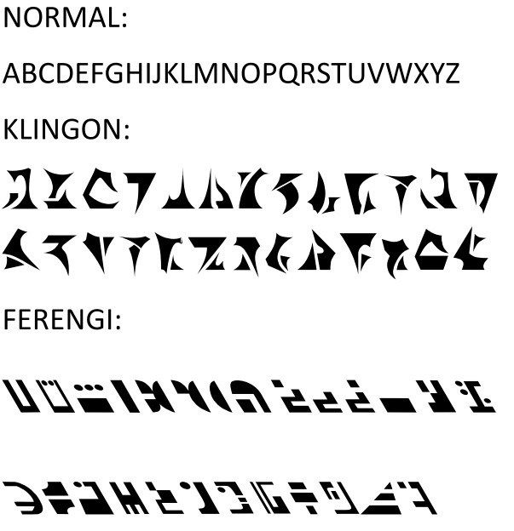
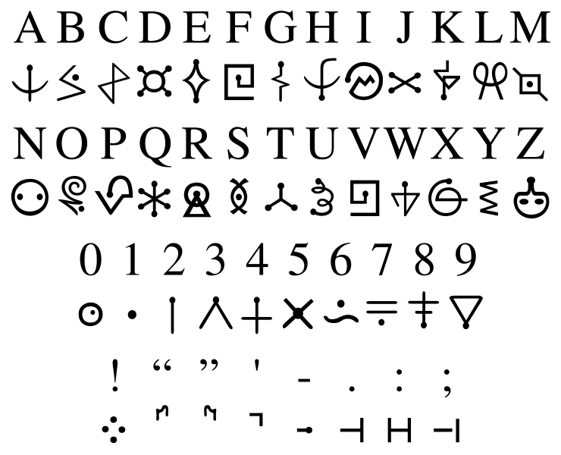
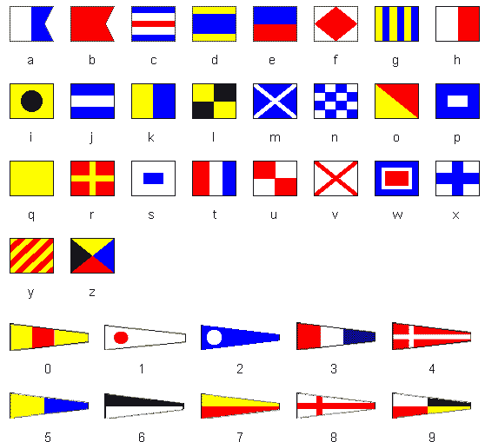
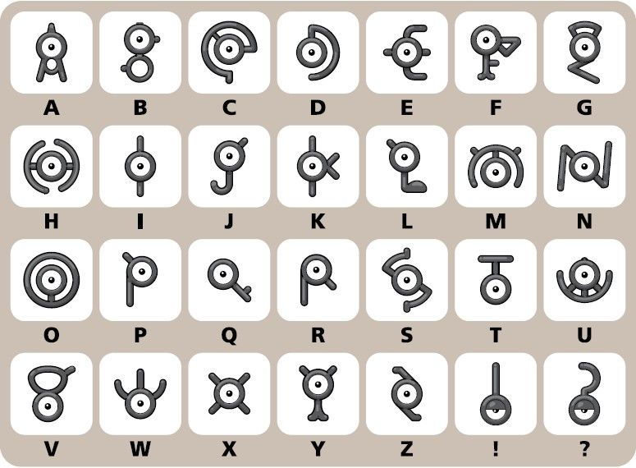
Substitution Ciphers Cont.
Symbolic Ciphers: These ciphers will replace the letter with some sort of symbol.
Think of the pokemon “unknown”, Star trek alphabets, or Futurama alphabet.
This can also be something like the flag cipher, where letters are replaced with flags

Slide 11
Methods of Cracking Ciphers: With Tools
Before we list some methods by hand, there are ways to do it automatically with technology! Do know that it is important to know how they work because sometimes competitions or people will do sneaky things (such as using an entirely different alphabet!)
All below tools do very similar things, so you may need to hop from tool to tool, but usually they all have some form of cipher identifier/analyzer as well as cipher specific tools.
https://gchq.github.io/CyberChef/ - This is your best friend in a lot of other categories too
https://www.boxentriq.com
https://rumkin.com/tools/cipher/
https://www.dcode.fr/en
https://github.com/Ciphey/Ciphey - None web based tool, but will literally do everything for you, to the best of its ability.
https://quipqiup.com/ - Cryptogram Solver only

Slide 12
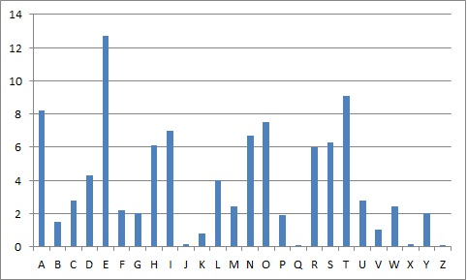
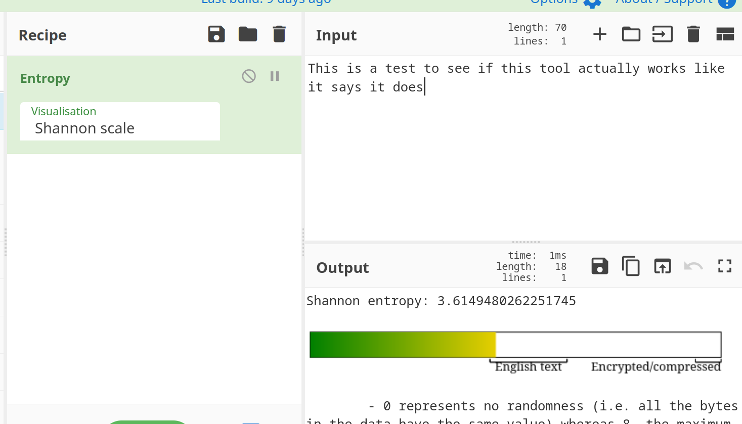
Methods of Cracking Ciphers: Analyze
The first step to cracking a cipher is to analyze it. Do you know a key or a way a key can be found (maybe brute force?). Does it look like it could be a substitution cipher or a transposition cipher? If you are using software, once you do this the rest is easy.
One way to do this is with letter frequency analysis! You can crack a lot of random substitution ciphers by analyzing the letter frequency and comparing it to the frequency in human english (left)
You can also check the entropy (basically how random are the letters) to get an idea if it is random or has some pattern.

Slide 13
Methods of Cracking Ciphers: Crack it!
Once you have identified a possible Cipher used, go find a tool meant for the cipher (listed a lot of resources a few slides back)
Sometimes you need a key! There are few ways to do this.
Maybe the key is listed in the question, so try using that
If the keyspace is small, you can brute force it! (ROT13 only has 26 possible combos!)
Sometimes you need to get creative and do things such as a known plaintext attack (Sometimes you know the flag format already)
Heavy math: Some more advanced and modern techniques will use a lot of math heavy ways to crack them, such as attacking RSA (Wiener’s attack) and such, though that is a bit out of scope of this presentation (take cs454 haha) I will leave this writeup that NCL gave as a hard question one year: https://blog.cryptohack.org/twitter-secrets

Slide 14
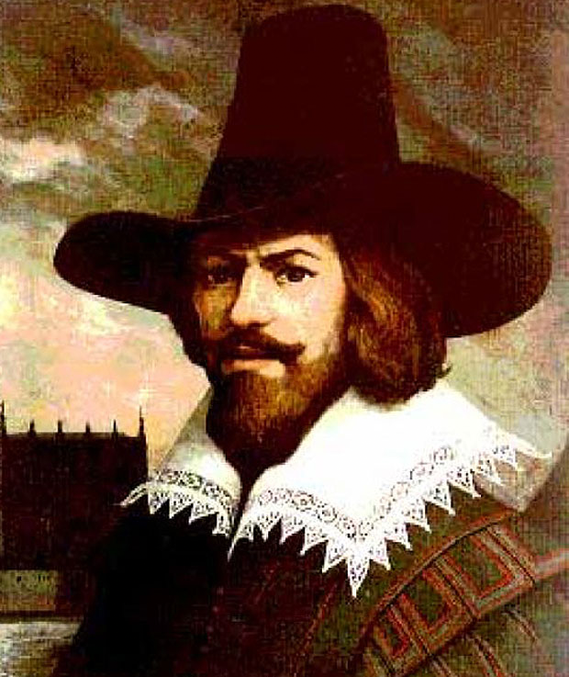
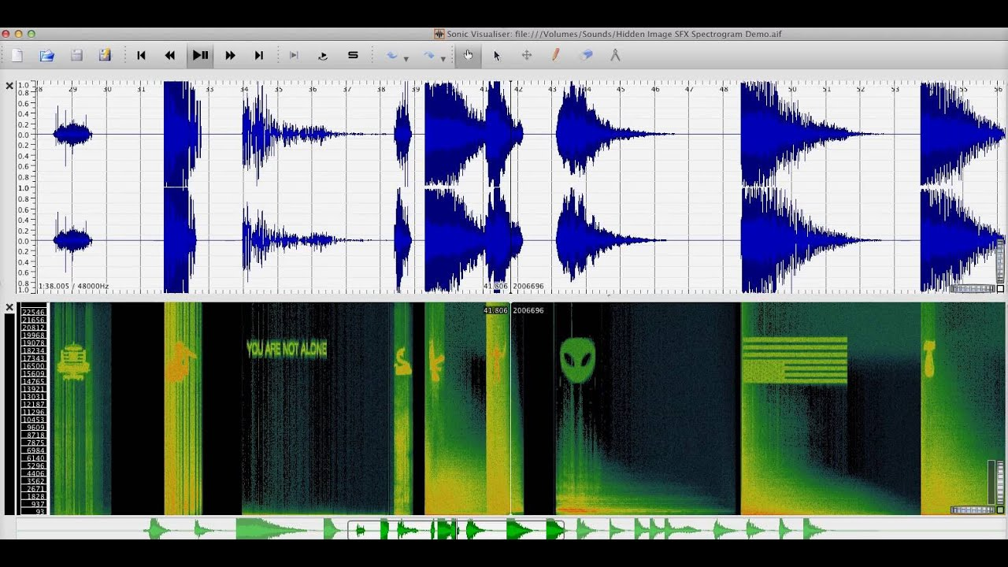

Steganography!
Steganography is similar to the previous methods but different as it involves hiding messages in another form of media (usually an image, but audio works too!) Examples from NCL:
On the left is a seemingly broken image, but looking through the actual file data you can find the hidden flag!
In the middle is a seemingly normal image but it actually has another image hidden inside of the data!
On the right is a spectrogram, which is just a view of an audio files frequency, and as you can see, there are hidden images and messages in it!

Slide 15
Steganography Tools
For NCL, they will mostly use something called the “Digital Ink ToolKit” and you can just feed images into there.
ExifTool or sites like FotoForensics can help analyze image files to see any hidden meta data
Steghide, Stegsolve, Openstego, jsteg, and many more tools can also be used! If the first tool doesn’t work, most of the time it is trial and error
https://book.hacktricks.xyz/crypto-and-stego/stego-tricks is a great resource for this
Audacity can be used to analyze audio frequencies as well.

Slide 16
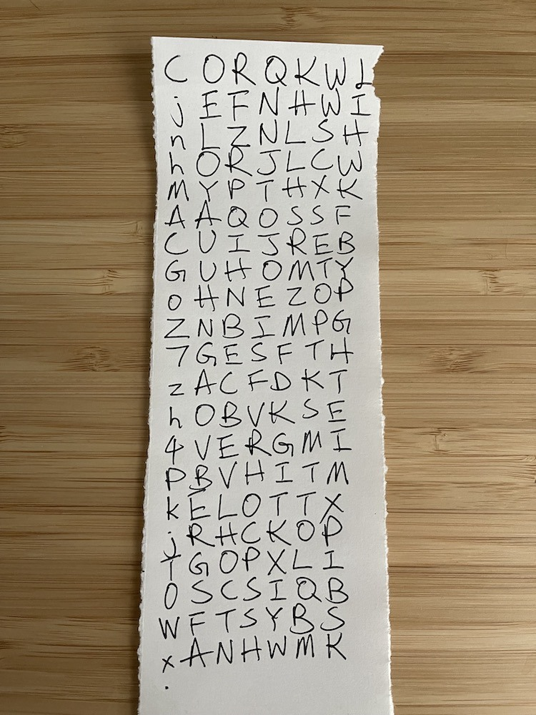
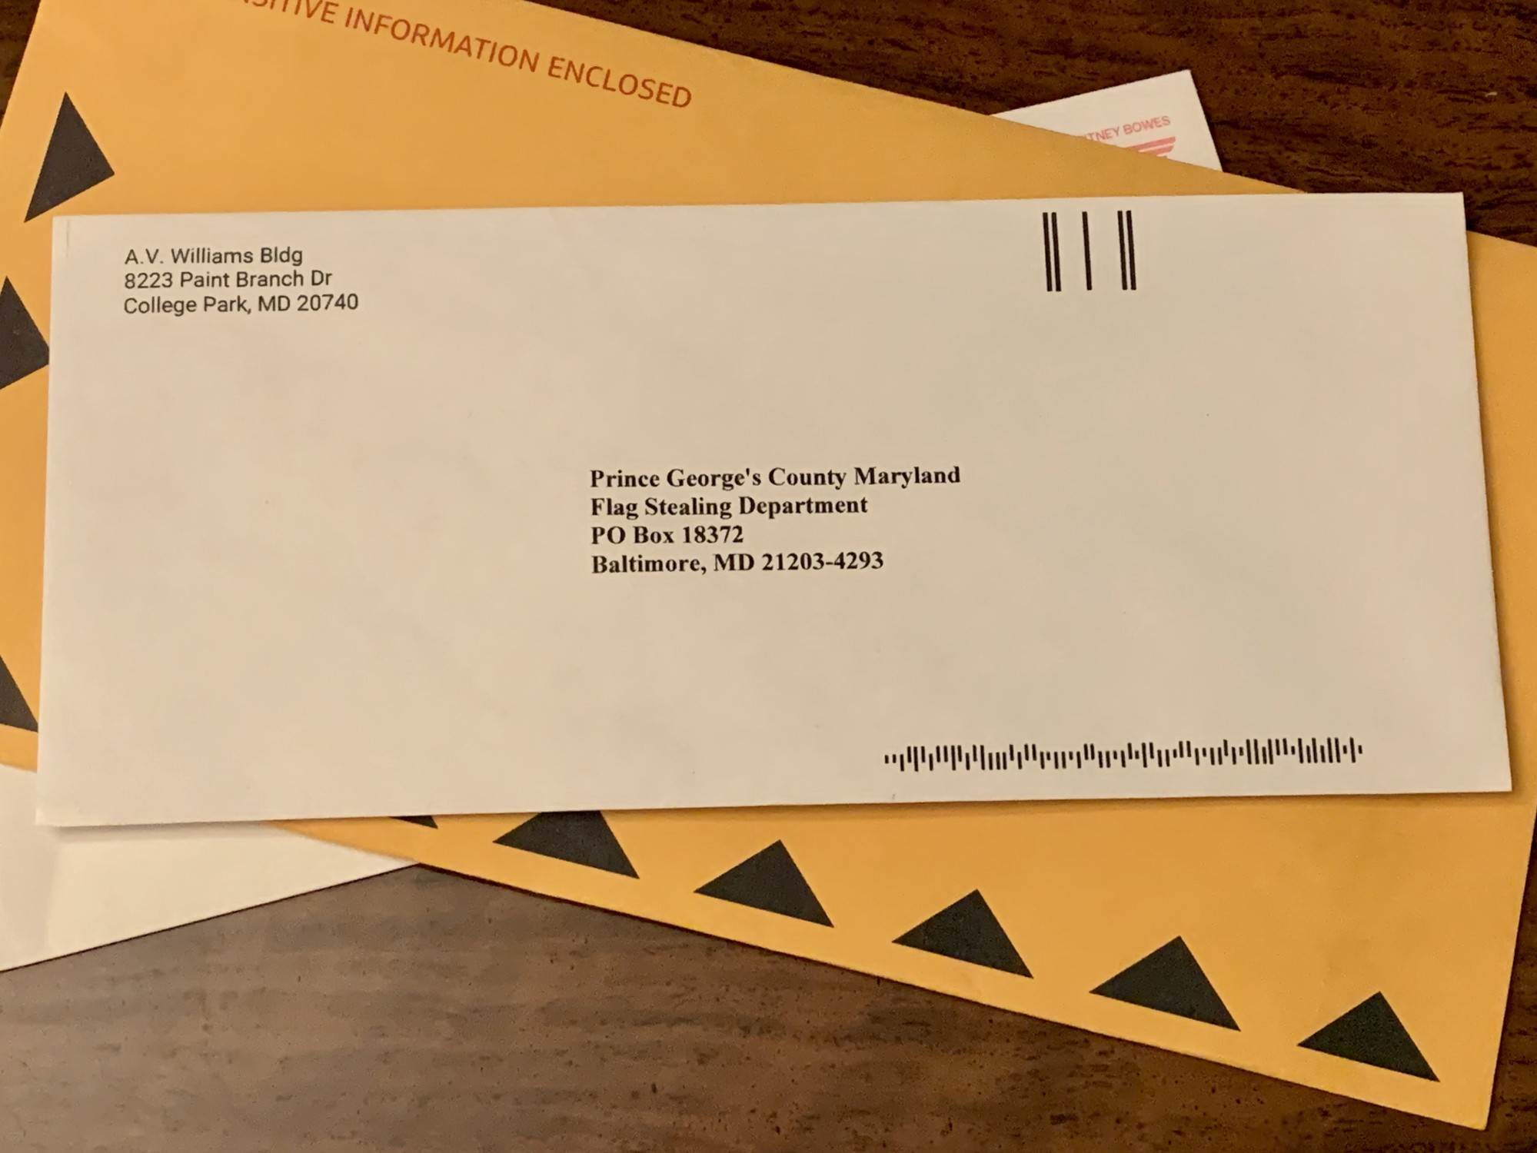
Tips
A lot of easier questions can be solved using some sort of tool, but it’s usually the harder questions that require a lot out of the box thinking.
Dont be afraid to try things! One year for NCL I was on the right track but gave up as noone else solved it… little did I know I was close to being the only one that solved it.
Some examples:
(left) This is from the university of maryland CTF. it involves using the USPS specific barcode decoder to get a string of numbers, which then can convert to ascii, which then can be shifted with ROT13 to get the flag. Talk about complicated.
(right) This is the NCL problem I was talking about. Essentially the first column is the key (notice the dot) and is all valid base64. “C” from b64 to binary is 000010, notice how there are only 6 other columns as well! The column that matches with the “1” (in this case 5th) will be the letter you select. Keep going row by row like this for the answer!

Slide 17
Challenges
Unfortunately I hadnt had time to make challenges but when I do they will be at https://github.com/NevadaCyberClub/knowledge-base as per usual
This doesnt mean I dont have resources! I will be going over some NCL problems after this slide!
Besides NCL, PicoCTF and other CTFs have great practice problems online!

